Slide 1


Slide 2
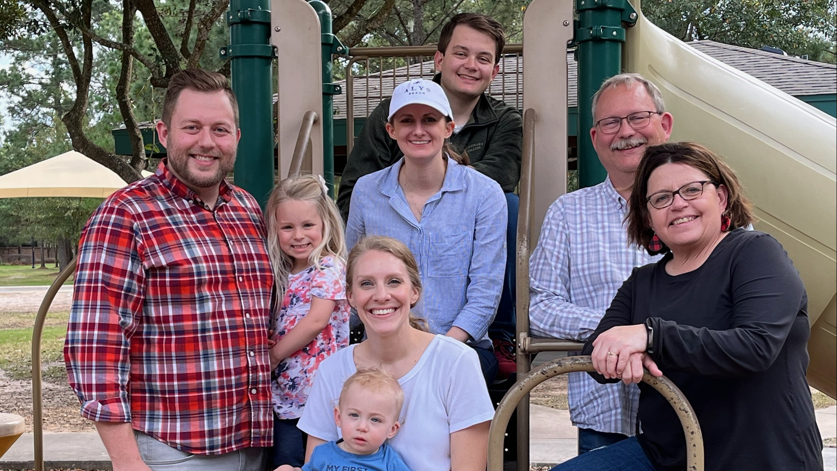

Slide 3


A Frozen Heart
No More

Slide 4

Love can thaw a frozen heart
Trusting Jesus is the start
Gave himself to wash our sin
Now forever live with him

Slide 5
Yes, Jesus Loves Me
Yes, Jesus Loves Me
Yes, Jesus Loves Me
A Frozen Heart No More

Slide 6
Though my heart was black as night
Now it’s clean and snowy white
Read God’s Word and daily pray
Trusting Jesus everyday

Slide 7
Yes, Jesus Loves Me
Yes, Jesus Loves Me
Yes, Jesus Loves Me
A Frozen Heart No More

Slide 9


Slide 10
Love can thaw a frozen heart
Trusting Jesus is the start
Gave himself to wash our sin
Now forever live with him

Slide 11
Yes, Jesus Loves Me
Yes, Jesus Loves Me
Yes, Jesus Loves Me
A Frozen Heart No More

Slide 12
Though my heart was black as night
Now it’s clean and snowy white
Read God’s Word and daily pray
Trusting Jesus everyday

Slide 13
Yes, Jesus Loves Me
Yes, Jesus Loves Me
Yes, Jesus Loves Me
A Frozen Heart No More

